Slide 1
Image Outpainting using Deep Generative Models
Team Members Panel Number:7
S.No | Reg.No | Name of the Student | Section
1 | CB.EN.U4CSE17050 | Y. SAI AKHIL | CSE A
2 | CB.EN.U4CSE17424 | ILAM. PRATHYUSHA | CSE E
3 | CB.EN.U4CSE17465 | T. P. V KRISHNA TEJA | CSE E
3 | CB.EN.U4CSE17628 | K.AJAY KUMAR REDDY | CSE F
Project Advisor: Dr. K. Raghesh Krishnan - Assistant Professor (Sr), Department of Computer Science and Engineering, Amrita School of Engineering, Coimbatore

Slide 2
‹#›
Problem Statement
To solve the problem of extrapolating visual context in images using deep generative models, i.e., extending image borders with plausible structure and details

Slide 3
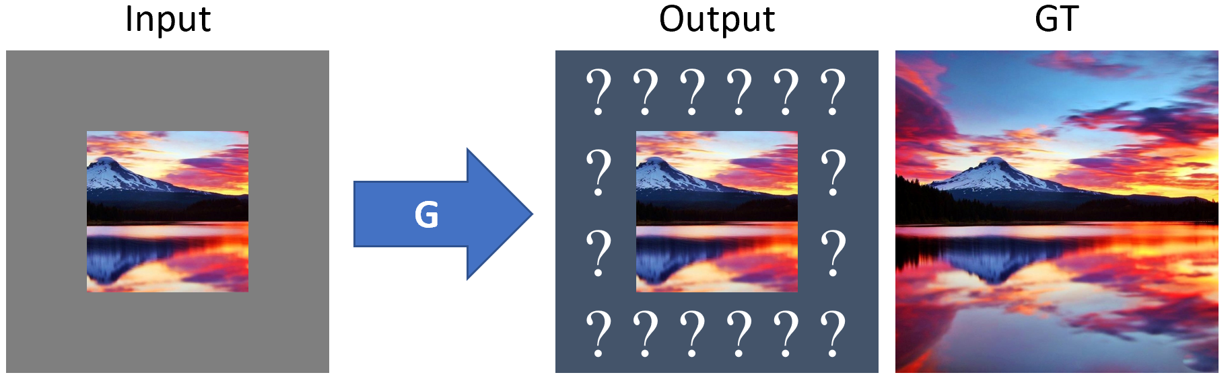
Outpainting Example

Slide 4
Literature Survey
S.No | Paper Name | Authors | Abstract
 | Painting Outside the Box:Image Outpainting with GANs (2018) | Mark Sabini • Gili Rusak | This paper aims to improve the existing solutions to image outpainting(also called as image extrapolation) by proposing a three-phase training process which involves training a DCGAN architecture on a part of the Places365 dataset. Also extended to Recursive Outpainting.
2. | Wide-Context Semantic Image Extrapolation (2019) | Yi Wang • Xin Tao • Xiaoyong Shen • Jiaya Jia | This paper aims to solve the problem of image extrapolation by utilizing the power of deep generative models. To overcome this, the authors have proposed a Semantic Regeneration network.

Slide 5
Literature Survey(contd.)
S.No | Paper Name | Authors | Abstract
3. | Very Long Natural Scenery Image Prediction by Out-painting (2019) | Zongxin Yang; Jian Dong; Ping Liu; Yi Yang; Shuicheng Yan | This paper mainly focuses on generating images that very large in size like panoramas by maintaining spatial and semantic consistent with original input. Skip Horizontal Connection (SHC) and Recurrent Content Transfer(RCT) are used.
4. | Multimodal Image Outpainting With Regularized Normalized Diversification (2019) | Lingzhi Zhang, Jiancong Wang, Jianbo Shi | This paper aims to find the possible background for the given input foreground region. Generally, the tendency of humans to predict the possible background for a foreground. The same is trying to be achieved by this model.

Slide 6
Literature Survey(contd.)
S.No | Paper Name | Authors | Abstract
5. | SiENet: Siamese Expansion Network for Image Extrapolation(2020) | Xiaofeng Zhanga, Feng Chenb, Cailing Wang a, Ming Taoa, Songsong Wua and Guoping Jianga | In this paper, he authors proposed a two-stage siamese adversarial model for image extrapolation, named Siamese Expansion Network (SiENet) and adaptive filling technique to predict images that are of high clarity.
6. | Painting Outside as Inside: Edge Guided Image Outpainting via Bidirectional Rearrangement with Progressive Step Learning (2020) | Kyunghun Kim , Yeohun Yun , Keon-Woo Kang, Kyeongbo Kong , Siyeong Lee, and Suk-Ju Kang | This paper aims to perform outpainting by using both outpainting and inpainting. This model is divided into two sections: an edge map generation network and an image completion network.

Slide 7
Literature Survey(contd.)
S.No | Paper Name | Authors | Abstract
7. | Image Outpainting: Hallucinating Beyond the Image (2020) | Qingguo Xiao, Guangyao Li, Qiaochuan Chen | In this study, they proposed a novel image-to-image synthesis architecture to deal with a challenging issue - image outpainting. The designed model using this architecture generated high-quality results.
8. | Enhanced Residual Networks for Context-based Image Outpainting (2020) | Przemek Gardias, Eric Arthur, Huaming Sun | The process in this paper includes the GAN architecture which contains two major additions: the first being the use of residual blocks in the generator, and the second being the use of two discriminators.

Slide 8
Our GAN architecture comprises two innovative modules compared to a normal GAN:
Use of dense blocks in the generator along with other downsampling and upsampling layers.
Use of dual discriminators in the place of single discriminator to enhance the classifying ability of the discriminator and achieve better results.
System Design

Slide 9
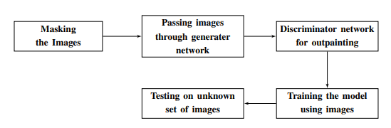
Flow Diagram

Slide 10
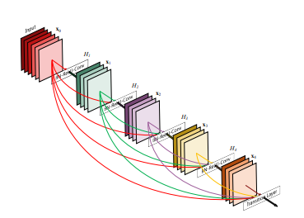
Dense Block
Essentially, Dense Block concatenate incoming feature maps.
In a Dense Block, the dimensions of the feature maps remains constant within a block, but the number of filters changes between them. These layers between them are called Transition Layers and take care of the downsampling applying a batch normalization, a 1x1 convolution and a 2x2 pooling layers.
Every layer has access to its preceding feature maps, and therefore, to the collective knowledge. Each layer is then adding a new information to this collective knowledge,

Slide 11
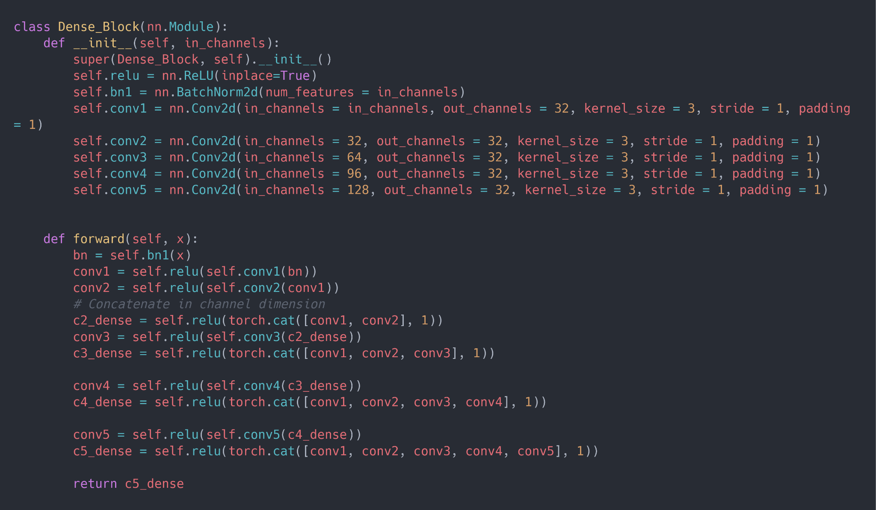
Implementation
Dense Block

Slide 12
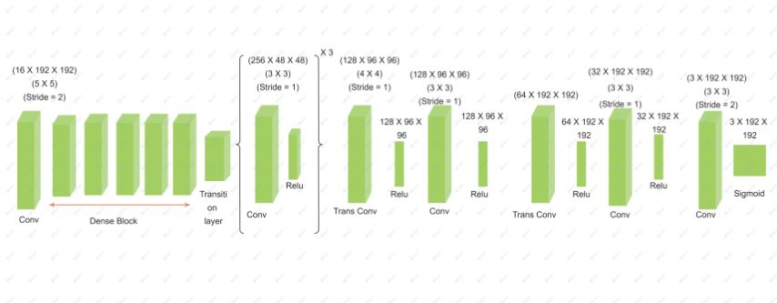
Architecture Diagram - Generator

Slide 13
The Generator tries to understand features in an image and then outputs an image having spatial and feature consistency using de-convolutional layers.
The image is passed into the dense block where the features from one layer is concatenated with all the features from the previous layers to be passed to next layer.
Next the dense block output is passed to series on downsampling and upsampling layers to get a image with feature consistency.
Generator

Slide 14
Dual discriminator plays a major role in the model which includes:
Global Discriminator: This discriminator compares the whole predicted image with the ground truth image to distinguish the original and fake image.
Local Discriminator: This discriminator uses the the part of hallucinated outpainted features alone to be compared with the ground truth image, to immediately identity the generated image as original or fake.
The outputs from the local and global discriminator is averaged and taken as the output of the combined discriminator.
Discriminator

Slide 15
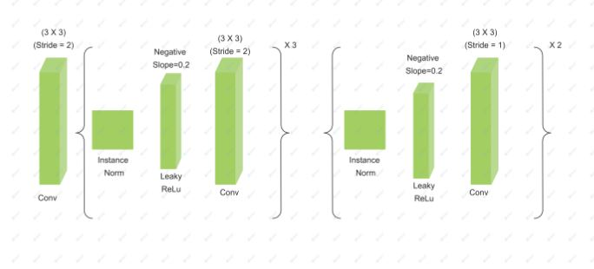
Architecture Diagram - Discriminator

Slide 16
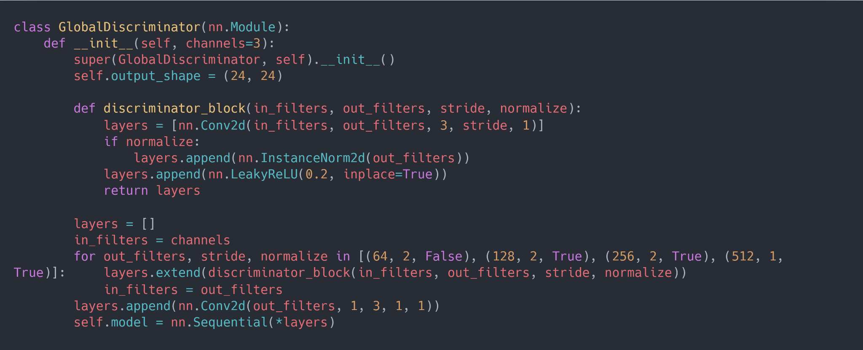
Implementation(contd.)
Global Discriminator

Slide 17
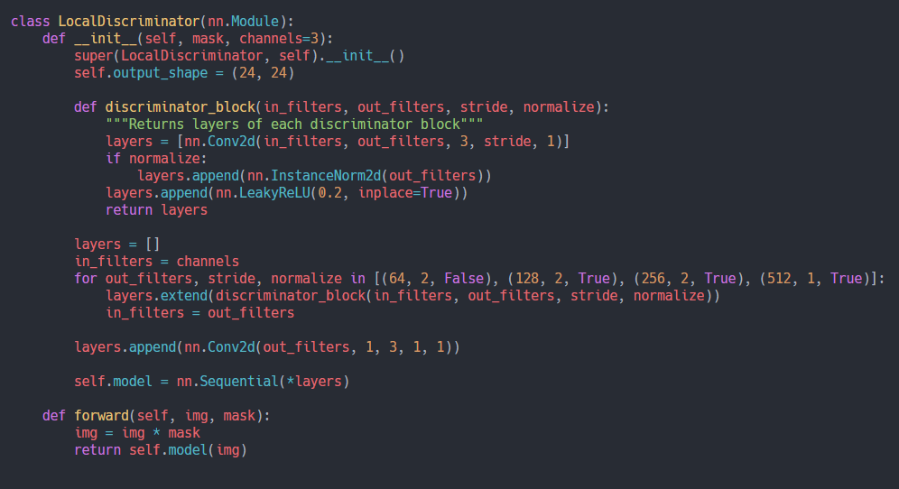
Implementation(contd.)
Local Discriminator

Slide 18
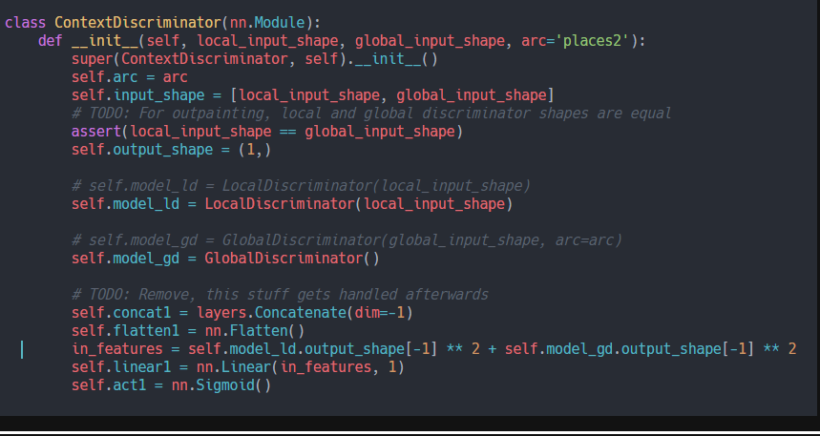
Implementation(contd.)
Context Discriminator

Slide 19
Implementation
Training Phase
Preprocessing
The Initial image is resized to size 192x192.
Then a mask is applied on the image such that the only the center part of the image is considered with dimensions of 128x128.
This masked image is fed as input to the generator.

Slide 20
Implementation(contd.)
Training Phase(contd.)
The generator takes the masked input image and passes it through a dense block followed by a series of convolutional layers which essentially downsamples the masked input, in order to efficiently capture the image content and object semantics within some embedding space.
Next, the decoder consists of a special kind of layers called up-convolutional or deconvolutional layers to ‘undo’ the downsampling performed by the encoder.

Slide 21
Implementation(contd.)
Training Phase(contd.)
Global Discriminator
The ground truth images and the predicted image from the generator is passed into the global discriminator.
The global discriminator uses the Conv2d, InstanceNorm2d, LeakyReLU functions to exact different layers from the image which can help to train the model and also find loss.
The discriminator then learns from the mistakes and learn with backpropagation.

Slide 22
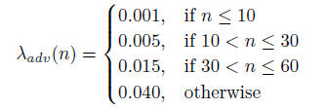
Implementation(contd.)
Training Phase(contd.)
Taking into account the size of dataset and time taken for computation the number of training epochs is limited to 150 .
We have decided to use two Adam optimizers and a constant learning rate of alpha=0.0003.
Also to punish the generator for generating bad images as there is a progress in time, we have used a loss function that varies with time to solve the loss function that is being used by the generator.

Slide 23
Implementation(contd.)
Training Phase(contd.) -
Adversarial Training
During discriminator training, we ignore the generator loss and just use the discriminator loss, which penalizes the discriminator for misclassifying real faces as fake or generated faces as real. The generator’s weights are updated through backpropagation. Generator’s weights are not updated.
During generator training, we use the generator loss, which penalizes the generator for failing to fool the discriminator and generating a face that the discriminator classifies as fake. The discriminator is frozen during generator training and only generator’s weights are updated through backpropagation.
It's this back and forth training between GANs that we call as Adverserial Training.

Slide 24
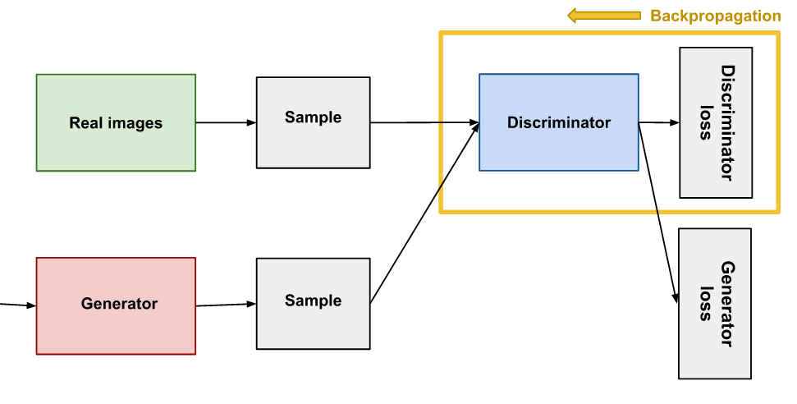
Implementation(contd.)
Training Phase(contd.) -
Adversarial Training(contd.)
Masked Image
Backpropagation in Discriminator Training

Slide 25
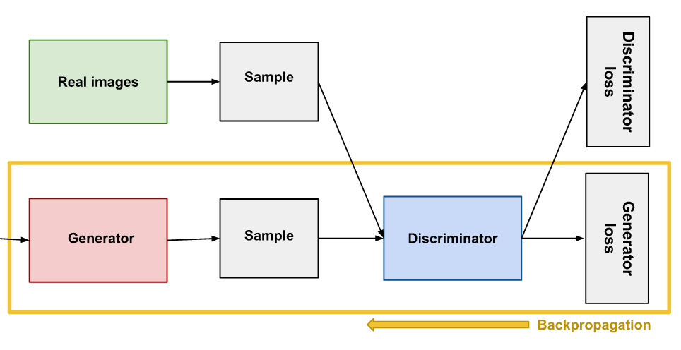
Implementation(contd.)
Training Phase(contd.) -
Adversarial Training
Adversarial Training(contd.)
Masked Image
Backpropagation in GeneratorTraining

Slide 26
Implementation(contd.)
Testing
Steps included:
Traditionally, testing is done using the input and the output are given as arguments once the model is trained successfully.
In the same way, the input file path and the output file path for the input image and output image are passed as arguments respectively.
Testing also goes in the way the training is performed preprocessing for the image is done, model is applied and finally the image is blended.
Blending plays an important role in outpainting such that features of the image is preserved.

Slide 27
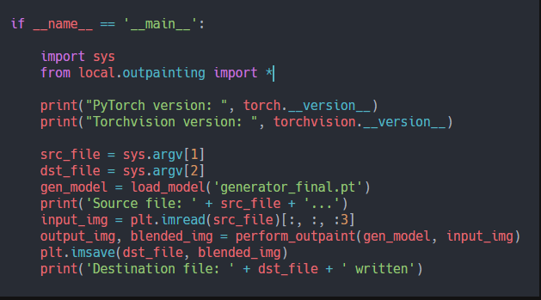
Implementation
Testing

Slide 28
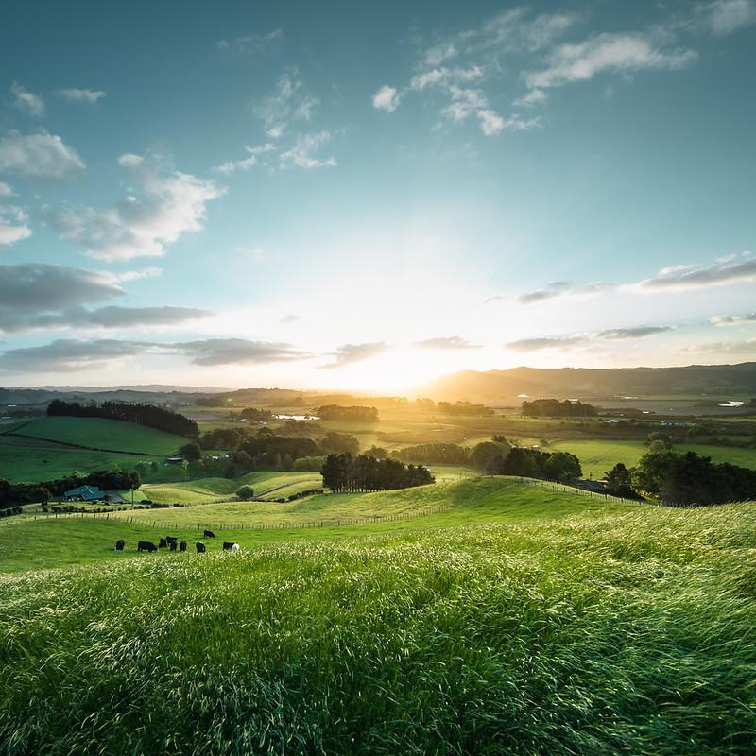
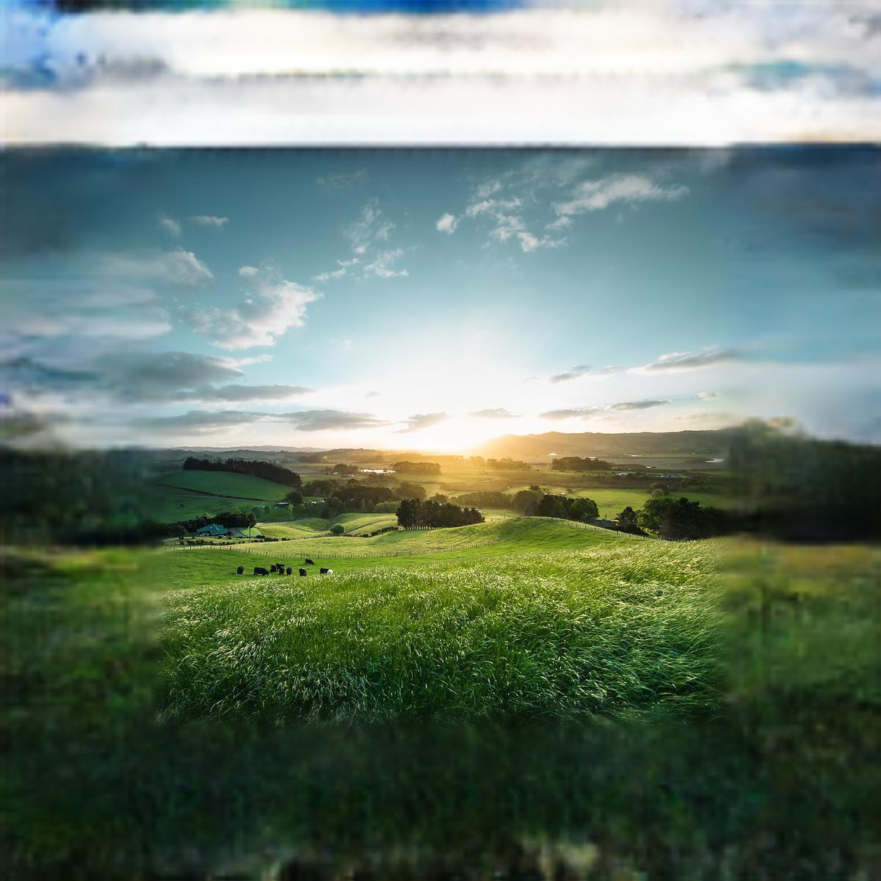
Results during Testing
Input Image
Outpainted Image

Slide 29
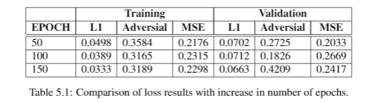
Result / Inferences
Comparison of loss results with increase in number of epochs(cats and dogs dataset)
EPOCH | Training |  |  | Validation
 | L1 | Adversial | MSE | L1 | Adversial | MSE
50 | 0.0825 | 0.5171 | 0.1627 | 0.0838 | 0.5586 | 0.1691
100 | 0.0694 | 0.2998 | 0.2319 | 0.0851 | 0.3432 | 0.2537
150 | 0.0601 | 0.4387 | 0.1929 | 0.0846 | 0.2855 | 0.2190
Comparison of loss results with increase in number of epochs(cats and dogs dataset)

Slide 30
Comparison & Analysis
Image outpainting and harmonization
EPOCH | Validation
 | L1 | Adversial | MSE
50 | 0.0838 | 0.5586 | 0.2691
100 | 0.0851 | 0.3432 | 0.2537
150 | 0.0846 | 0.2855 | 0.2199
Enhanced Residual Networks for Context-based Image Outpainting
EPOCH | Validation
 | L1 | Adversial | MSE
50 | 0.0729 | 0.3542 | 0.3470
100 | 0.0754 | 0.3684 | 0.3173
150 | 0.0770 | 0.4217 | 0.3511
These are the losses of existing models using the same dataset that we used
Losses of existing models is comparatively larger than the model which we implemented
From the above table, we can see that the all the three loss values are significantly lower compared to loss values from majority of the existing architectures for image outpainting. Hence, we can tell that our proposed architecture outperforms all of the current models.

Slide 31
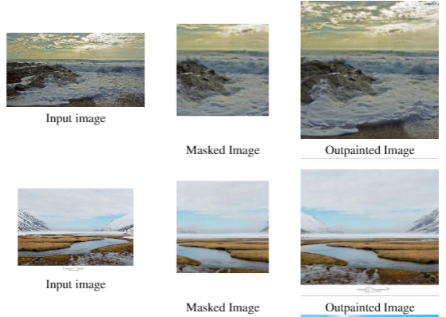
Outpainting Results after Training

Slide 32
Discussion
The biggest challenge we faced while conducting our experiment was the training set size and the number of epochs we could train our model for. Since we have reduced the number of images drastically from 4300 to 1300, the model was not able to effectively learn complex features such as human, water and tree details from an image. This problem further gets stacked since there were a very small subset of images that had humans in them.
Since we are using fixed average between local and global discriminator, it makes the model to weigh the overall image and boundaries equally, leads to the output images generated to be of lower quality(blurred). The probable way to overcome this issue is to form a function that back propagates to discriminator which will allow the model itself to decide on how to mix the outputs from local and global discriminator.

Slide 33
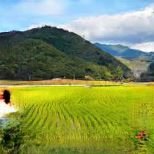
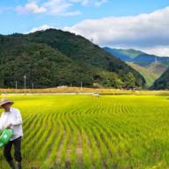
Discussion(contd.) - Anomaly
Outpainted Image Original Image
We can observe that in the outpainted image on the left, the human at the bottom left of the image is distorted and very hard to recognize when compared to the original image on the right, where we can clearly observe the a person. This tells us that the masked image which we might have provided to the model has removed the human from the original image, thereby the model thinking that a human was not present in the image and proceeded to outpaint using this knowledge.

Slide 34
Conclusion
Outpainting photos is a fun and challenging process, but it's currently plagued by substandard or obviously phoney results. The model we showcased using a dense block in the generator combining with a context discriminator results in producing more consistent output images, as well as displays the ability to carry object boundaries into newly created areas. This is an improvement over previous models, and it shows promise in terms of improving the quality of output.

Slide 35
References
Q. Xiao, G. Li and Q. Chen, "Image Outpainting: Hallucinating Beyond the Image," in IEEE Access, vol. 8, pp. 173576-173583, 2020, doi: 10.1109/ACCESS.2020.3024861.
Gardias, P., Arthur, E., and Sun, H. (2020). “Enhanced residual networks for context-based image outpainting.
Kyunghun Kim, Yeohun Yun, K.-W. K. K. K. S. L. and Kang, S.-J. (2020). “Paintingoutside as inside: Edge guided image outpainting via bidirectional rearrangement with progressive step learning
Lingzhi Zhang, Jiancong Wang, J. S. (2019). “Very long natural scenery image predic-tion by outpainting.
Sabini, M. and Rusak, G. (2018). “Painting outside the box: Image outpainting withgans.
Wang, Y., Tao, X., Shen, X., and Jia, J. (2019). “Wide-context semantic image ex-trapolation.”2019 IEEE/CVF Conference on Computer Vision and Pattern Recognition(CVPR). 1399–1408.
Xiao, Q., Li, G., and Chen, Q. (2020). “Image outpainting: Hallucinating beyond theimage.”IEEE Access, 8, 173576–173583.
Xiaofeng Zhang, Feng Chen, C. W. S. W. M. T. G. J. (2020). “Sienet: Siamese expan-sion network for image extrapolation.
Zhang, L., Wang, J., and Shi, J. (2019). “Multimodal image outpainting with regular-ized normalized diversification.”CoRR, abs/1910.11481
Gao Huang, Zhuang Liu, Laurens van der Maaten, Kilian Q. Wilianberger.(2018). “Densely Connected Convolutional Networks.”. arXiv:1608.06993v5

Slide 36
THANK YOU

